Slide 1
It’s Not You, It’s PowerPoint: Why it’s time to fall in love with real-time reporting
Lieutenant General Karen Dyson, US Army (ret.)
Brian Brinkmann, Agilence Inc
Ben Mathew, Qrvey
Ryan McCullough, Decision Lens
Moderator: Josh Martin, Decision Lens

Slide 2
Introductions
Karen Dyson
Lieutenant General, U.S. Army (Retired)
Former Military Deputy to the ASA (FM&C)
Currently Independent Director for USAA Federal Savings Bank, Genworth and CALIBRE
Brian Brinkmann
Chief Product & Marketing Officer
Agilence, Inc
Ryan F. Mc Cullough, Ph.D.
Director, DoD Solutions Engineering
Decision Lens
Ben Mathew
Chief Revenue Officer
Qrvey
Josh Martin
Executive Vice President of Marketing
Decision Lens

Slide 3
3 Key Takeaways
Best Practices to Improve Reporting
3 ways to make data more actionable
Line of sight into future changes
Josh Martin
Executive Vice President of Marketing
Decision Lens
Notes:
Why do we use what we use
Easy access – we all have these tools readily available to us. It is estimated that 500M people use powerPoint
Easy to use – We can all make reasonably decent looking slides and presentations with PowerPoint. Been in the market for 20+ years and even now 6M+ teachers rely on PowerPoint every day
Wide availability – People are accustomed to receiving information in PowerPoint. Microsoft owns 95% of the presentation market
Finally, Microsoft estimates that over $250 million is wasted per day due to poor PowerPoint presentations
So, PowerPoint, Keynote, Slides and other software are all very useful and play a critical role in presentations – but they are not reporting tools and certainly not strategic planning options.
Why not
Hard to get data in and keep it updated
Limited options on charts and graphs
Out of date as soon as it is created – need time to make it look pretty
Today, we’re going to talk about a better way forward. The tools available to you, best practices you can implement today and how the reporting is changing and what you can and should expect in the future.

Slide 4
Financial Management Reporting
Manual Processes
Static Information
Challenges and Opportunities: People, Technology, & Process
Karen Dyson
Lieutenant General, U.S. Army (Retired)
Former Military Deputy to the ASA (FM&C)
Currently Independent Director for USAA Federal Savings Bank, Genworth and CALIBRE

Slide 5
Step 1: Get the Data Right
How “Right” does data need to be?
Stop Debating, Start Solving
Shift the Data Culture
Brian Brinkmann
Chief Product & Marketing Officer
Agilence, Inc

Slide 6
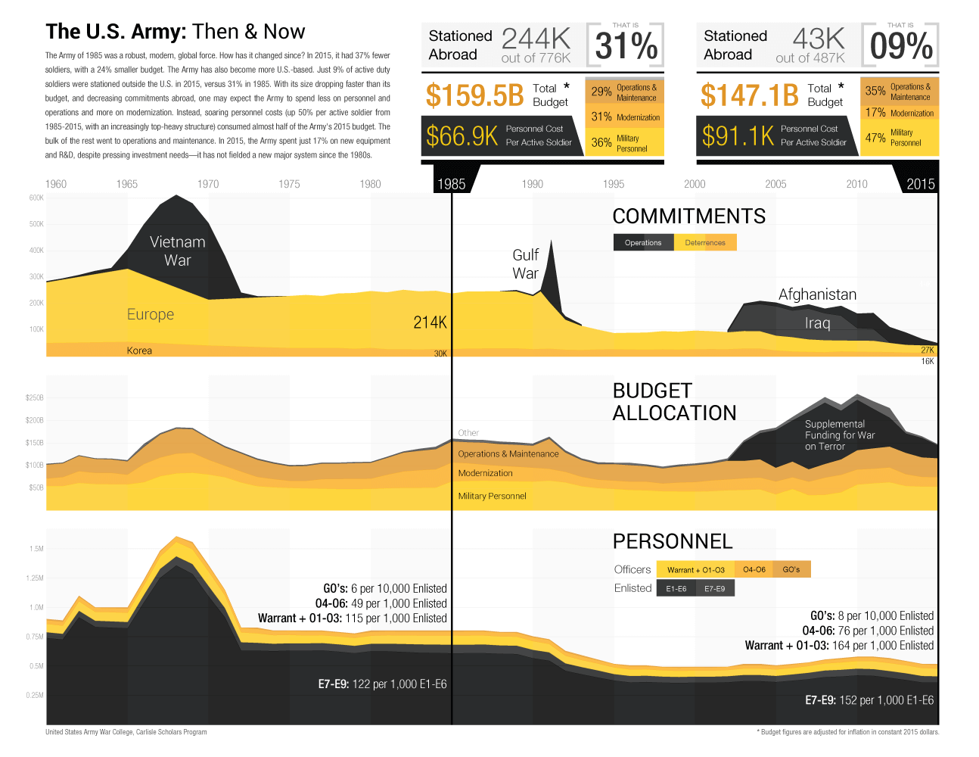
When you get data right, you can create compelling output
Source: Boost Labs

Slide 7
Step 2: Use what you have
Analytics versus reporting
Know what tools are available to you
Know how to use the tools available to you
Ryan F. Mc Cullough, Ph.D.
Director, DoD Solutions Engineering
Decision Lens

Slide 8
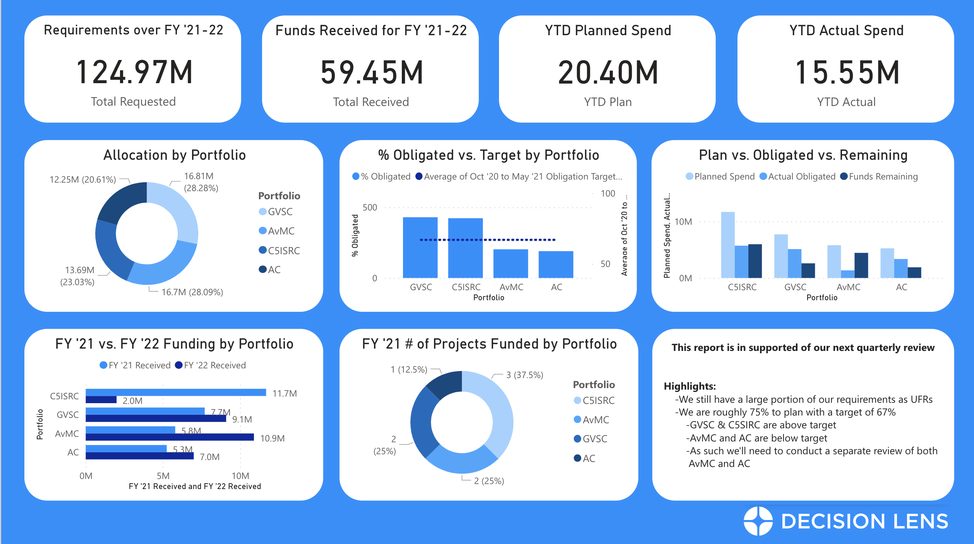
Analytics vs. Reporting, Aren’t They the Same?
Analytics
Reporting
Raw Data
Filtered Data
Information
Knowledge
Insights/Wisdom
Where Analysts Operate
Where Decision Makers Operate
“If there is any one secret of success, it lies in the ability to get the other person’s point of view and see things from that person’s angle as well as from your own” -Henry Ford

Slide 9
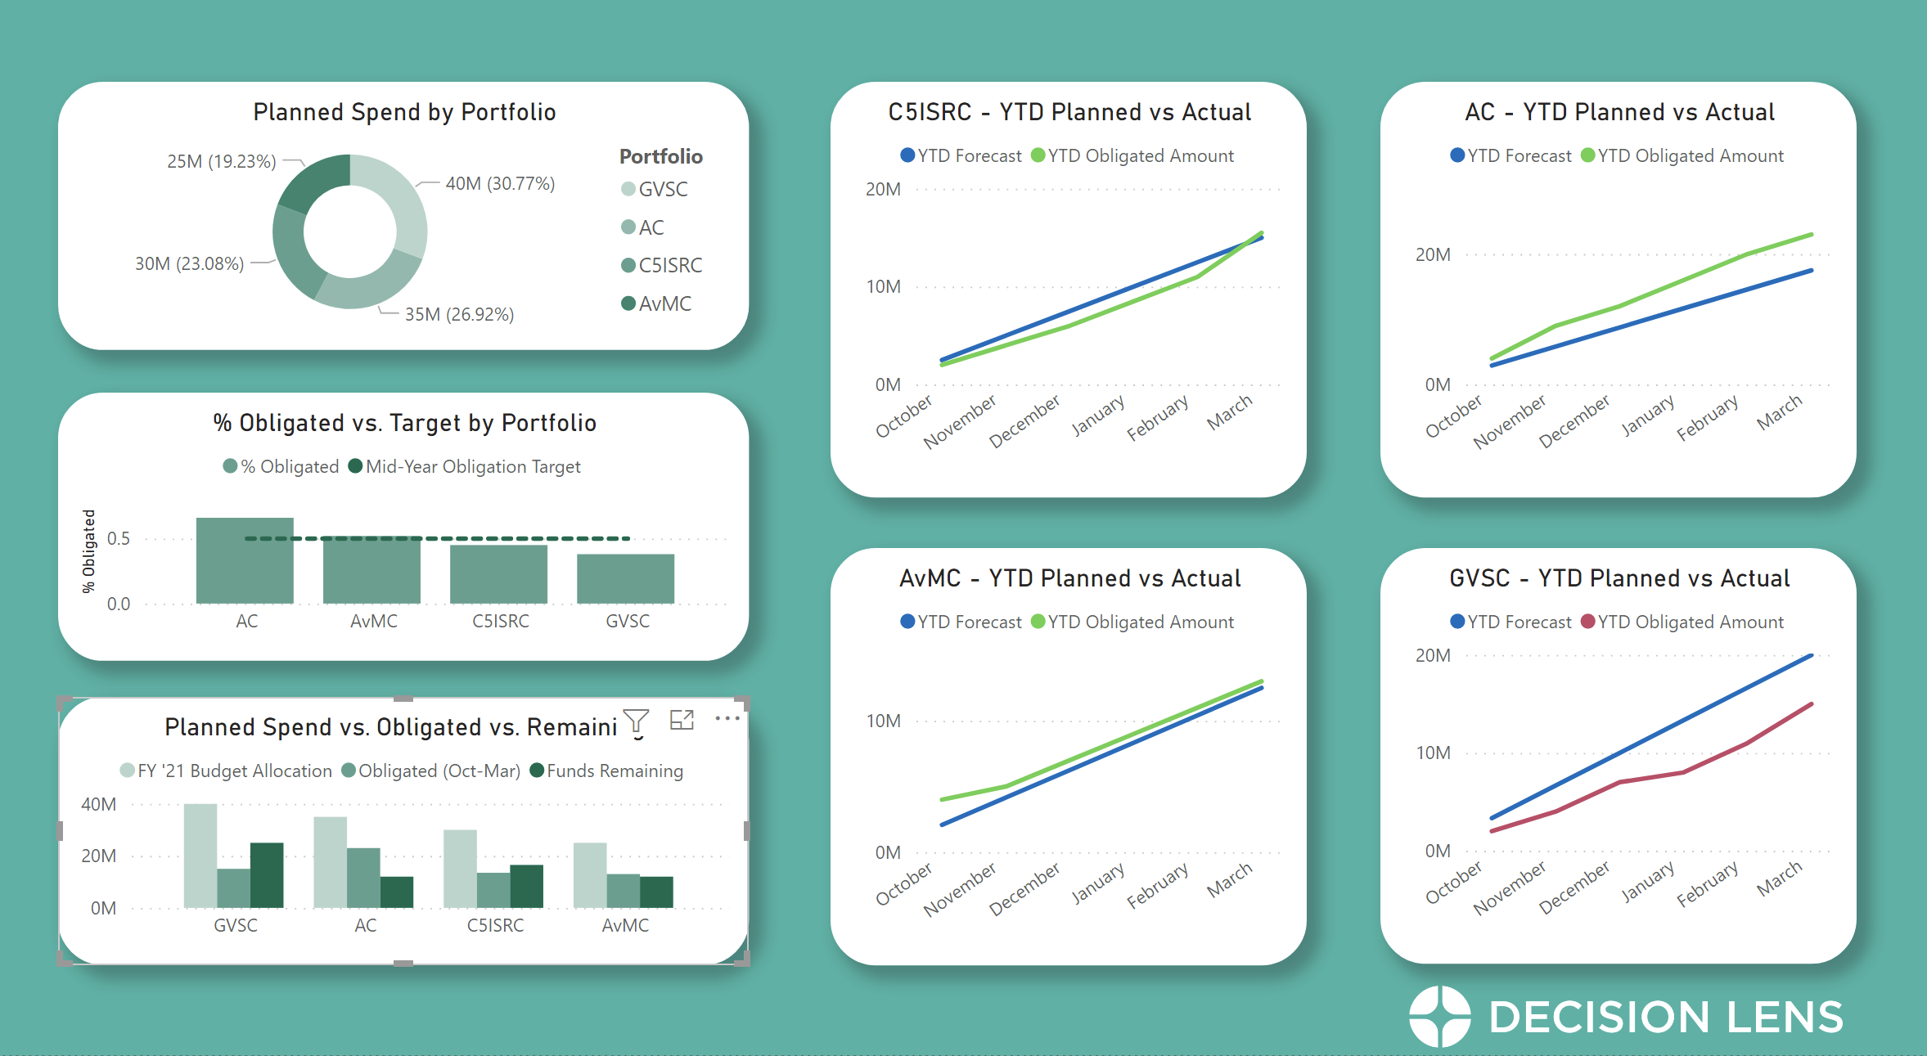
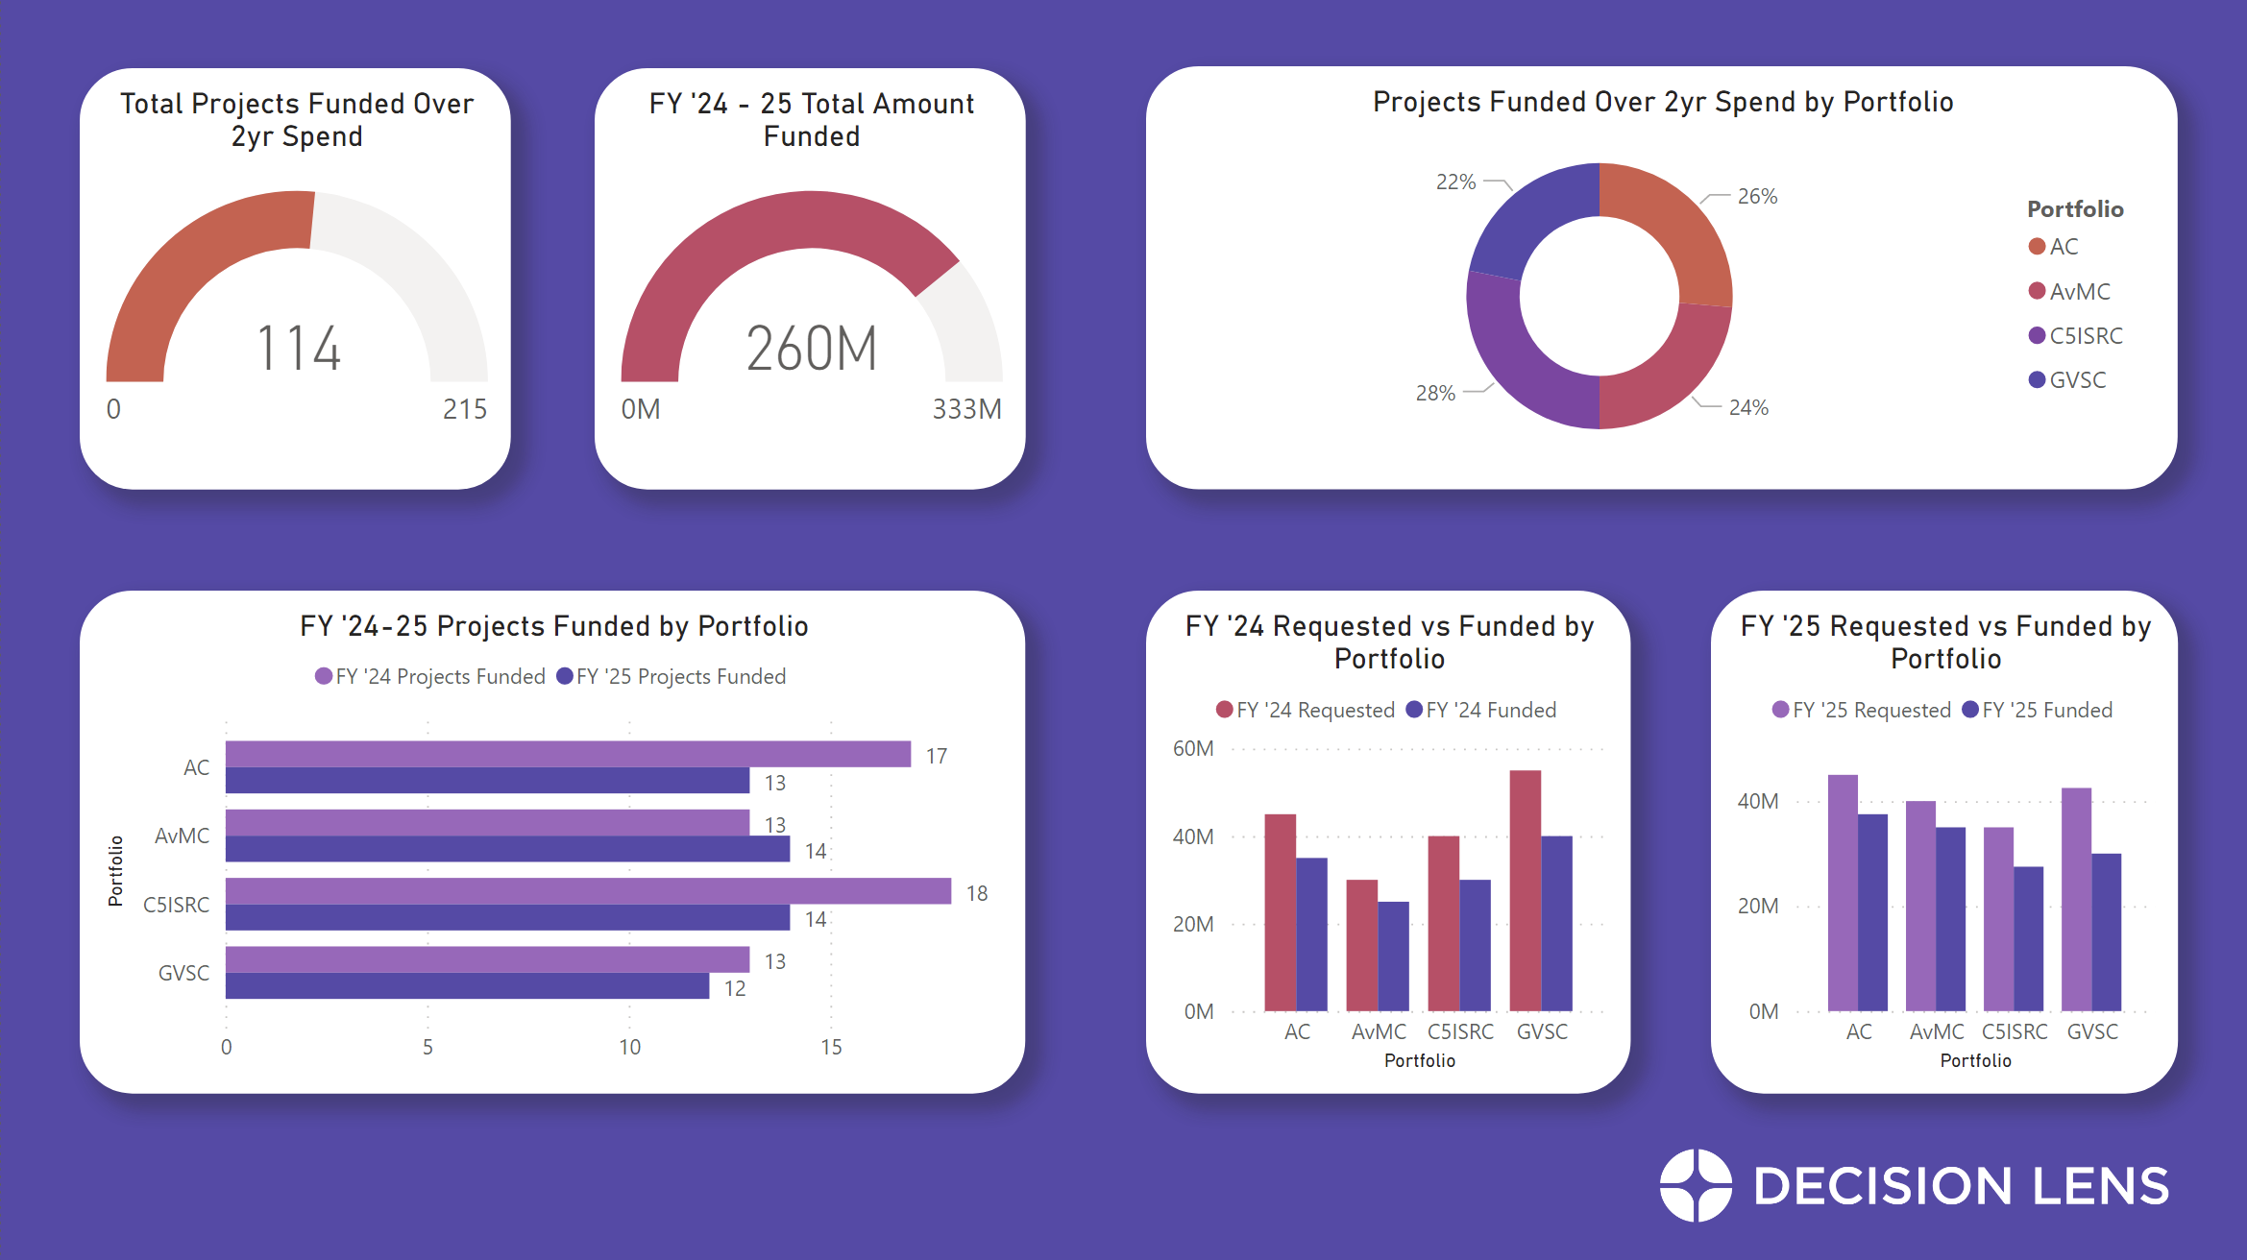
Knowing What is Available to You & How to Get Started Quickly
Access
Self-Service
Use Templates
Learning Curve
Progress not Perfection

Slide 10
Step 3: Using Analytics Efficiently
Embedded Reporting and Analytics
Benefits
Custom visualizations
No more swivel chair effect
The Future
Cloud-native
Automation everywhere
Ben Mathew
Chief Revenue Officer
Qrvey

Slide 11
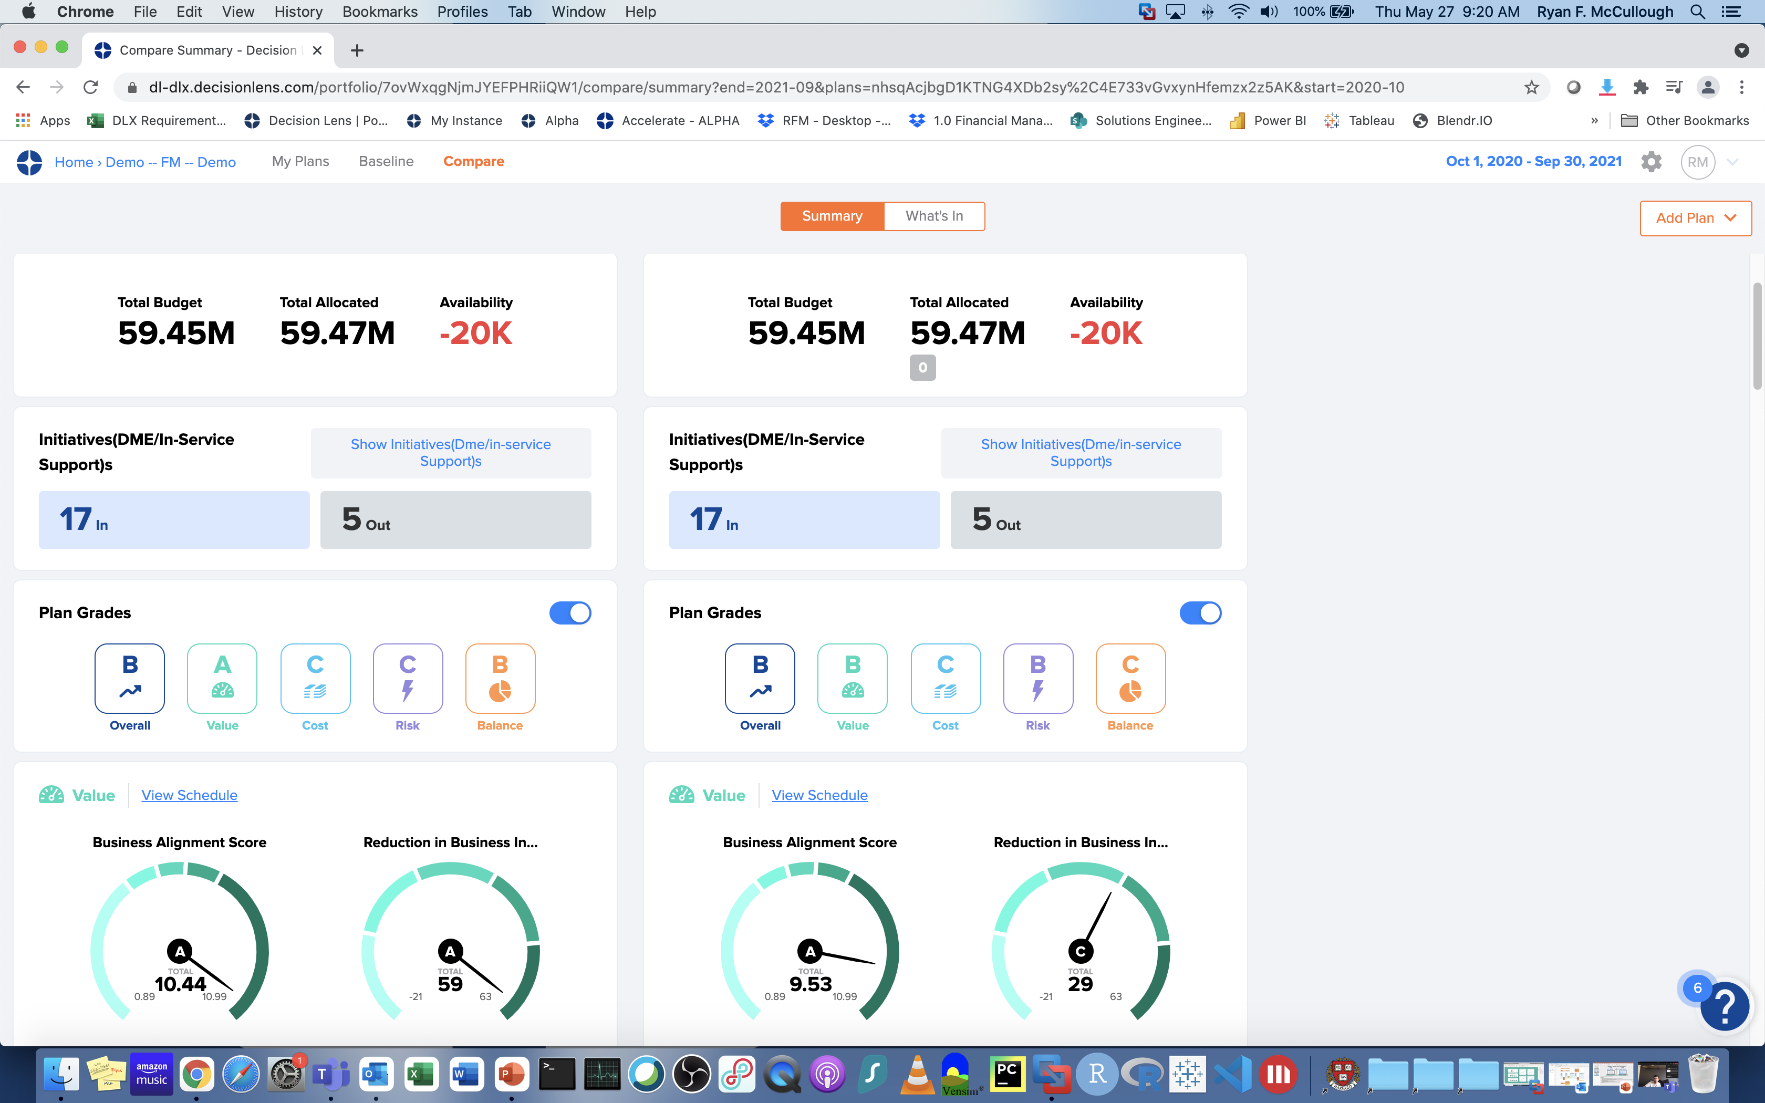
How Decision Lens uses Embedded Analytics

Slide 13
Better Reporting Requires all the Options
Get the Data Right
Use the tools you have
Use analytics efficiently
Consider the right medium
Notes:
Josh to wrap up here
Introduce the idea of the maturity model. Getting the data right really is the first step but it shouldn’t be scary. As Brian highlighted and we’ll delve into more in the Q&A there are ways to find and organize data that will dramatically improve your reporting right now.
You should determine the tools available to you because you may have access to more than you think. This could be a good introductory effort in building more basic dashboards and executive overviews to keep senior leadership informed
Evaluate if the tools you are using – or those you are considering buying -

Slide 14
Q&A

Slide 15
Thank You!
Karen Dyson
Karendyson11
@gmail.com
Brian Brinkmann
Bbrinkmann
@agilenceinc.com
Ryan McCullough
rmccullough
@decisionlens.com
Ben Mathew
Ben
@qrvey.com
Josh Martin
Jmartin
@decisionlens.com

